Slide 1


Google
How is how when when is when?
Google Search
I’m Feeling Lucky
Advertising
Business
About
Privacy
Terms
Setting

Slide 2

Google
The title is what?
All
Videos
Maps
Images
More
The Title
The description is about description is a long description is a good description is about it.
Point 1
The description is about description is a long description is a good description is about it.
Insert video here
Point 2
The description is about description is a long description is a good description is about it.

Slide 3
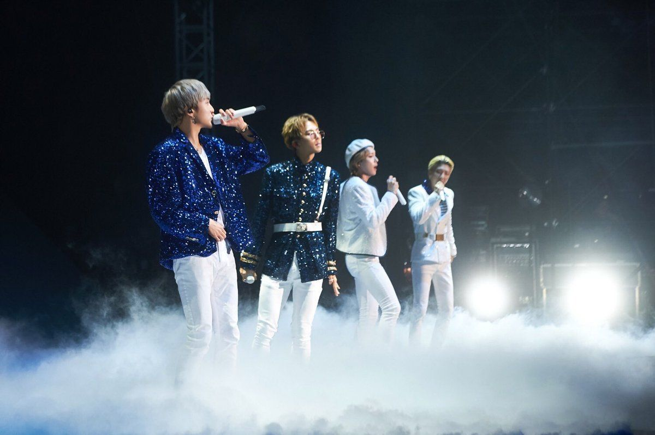
Google
The title
All
Videos
Maps
Images
More
This is point number one
This is probably number two
And this is point number three
This is point number four uwu
Insert picture description.jpeg

